Slide 1




Forest Hacks Hackathon
Sree Kokkonda, Yekalaivan Aiyanar, Tanishka Gangadharan Latha
EduBites: The TikTok for Learning

Slide 2
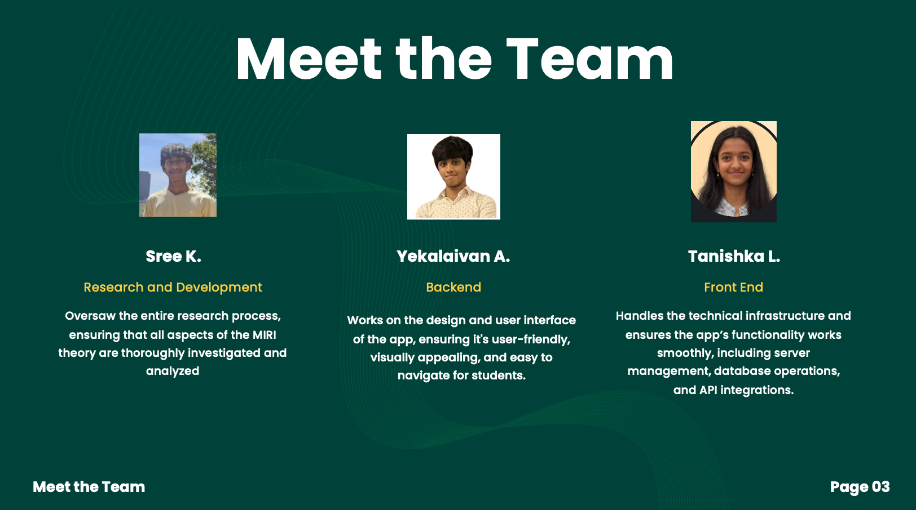

Slide 3

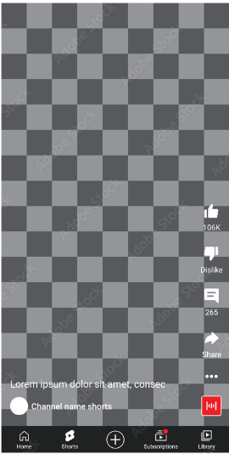





PROJECT
OVERVIEW
UNDERSTANDING THE MARKET
The current educational landscape lacks engaging, bite-sized content tailored to younger audiences. With attention spans becoming shorter, platforms like TikTok and YouTube Shorts have thrived by delivering personalized, short-form content. However, there is a gap in leveraging this model specifically for elementary education. Our goal is to fill that gap by creating a platform that merges personalized educational content with interactive engagement.
Forest Hacks Hackathon
EduBites
School Phone Ban
Attention Span
SOLUTION PROPOSAL
03
We propose EduBites, a short-form video platform designed for elementary students. Using AI, the platform curates educational content from a large video database, tracking user engagement and retention to personalize the learning experience. Our MVP will focus on providing a seamless, easy-to-navigate app interface that allows students to access relevant educational content quickly and enjoyably, encouraging replayability and growth.
The TikTok for Educagtion

Slide 4
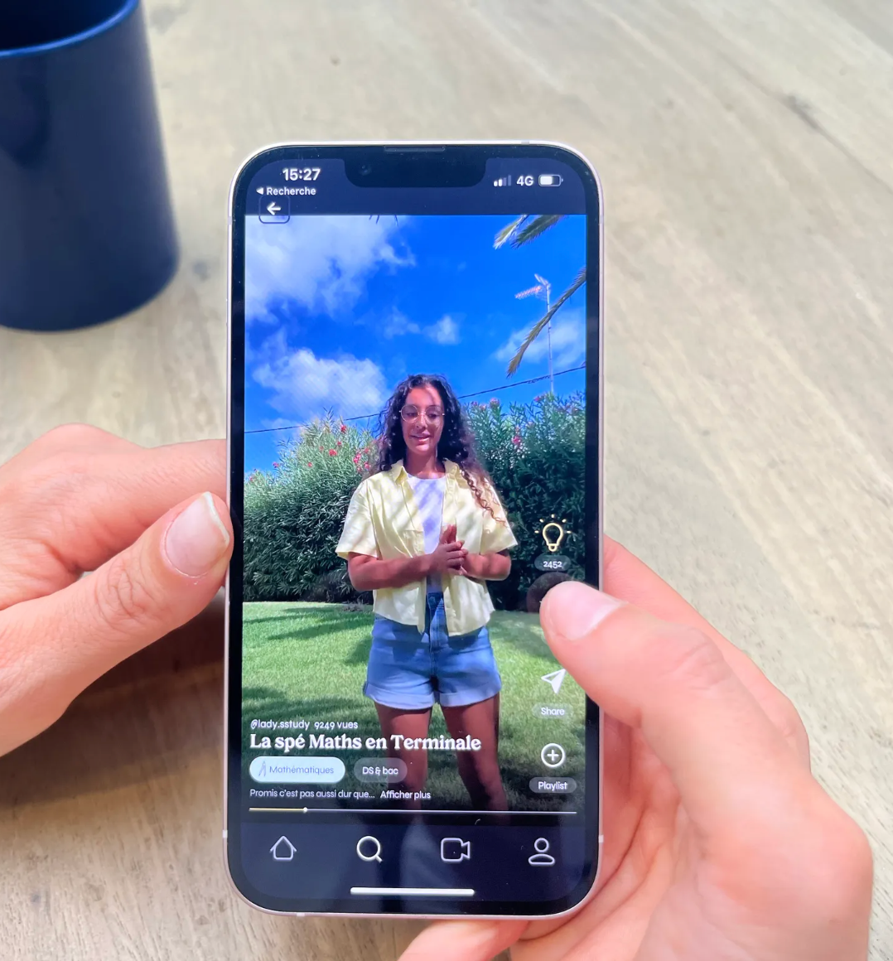



App Infrastructure
[ BENEFIT ]
Forest Hacks Hackathon
Content Delivery
Like Revyze, our platform will focus on curating educational videos. Videos will be short, engaging, and focused on helping students grasp key concepts efficiently.
EduBites
Revyze
Personalized Learning
Revyze – A similar app designed to replace tiktok and steer it towards education
Revyze’s recommendation system is built to provide relevant content to students. Similarly, our platform will use AI to track user engagement and adapt content recommendations based on individual learning progress and preferences.
04
The TikTok for Education
User Friendly
Younger Audience
The app will provide an easy-to-use interface where students can scroll through educational content, much like Revyze’s intuitive browsing experience.
While Revyze caters to students from a variety of academic levels, our platform will be optimized specifically for elementary school students, featuring age-appropriate content.

Slide 5



AI Technical Concepts
AI Video Fetching & Curation
Interactive Front End Feedback System
AI-Powered Content Recommendation System
Forest Hacks Hackathon
EduBites
User Engagement Data: Tracks users' interactions (likes, views, engagement time, emoji reactions) to create individual learning profiles.
Adaptive Learning: Recommends videos and games based on past engagement and performance, adjusting to each student's learning pace and preferences, similar to AI-driven platforms like TikTok and Revyze.
Machine Learning Model: The model will continuously evolve using supervised learning techniques, improving recommendations over time based on data collected.
Video Fetching from YouTube: An AI bot will pull appropriate educational videos from YouTube, filtering content based on predefined criteria like age-appropriateness, educational relevance, and quality.
Content Categorization: Once fetched, the AI will categorize content by subject, difficulty, and type (e.g., video, quiz, game) using natural language processing (NLP) techniques to ensure accuracy.
Seamless AI Integration: The front-end will provide a simple, intuitive interface, allowing users to scroll through educational content much like they would on TikTok or YouTube Shorts. AI recommendations will be integrated directly into the user experience.
Emoji-Based Feedback System: Users can react to content with emojis (happy, confused, sad) to provide immediate feedback on the usefulness and clarity of the content.
AI Sentiment Analysis: The system will analyze emoji reactions to determine which types of content are most effective, helping tailor future recommendations.
The TikTok for Education

Slide 6







PROJECT SCHEDULE
Forest Hacks Hackathon
PLACE SOME RELEVANT DETAILS HERE.
EduBites
WEEK 1
WEEK 2
WEEK 3
WEEK 4
WEEK 5
WEEK 6
Sree
Back End and Feedback System
Finish Algorithm
Research
Yeka
Research
Curate Content and Launch
Back End Database
FINAL PRESENTATION
09
Tanishka
Research
Market Research + Outreach
The TikTok for Education
Front End and UI/UX Design
You
Research
Program AI Bot for Fetching Videos
BUG FIX

